Slide 1
Web Application Interacting with Database Java Database Connectivity

Slide 2
Objectives
How to access database from web application?
JDBC
Relational Database Overview
JDBC and JDBC Drivers
JDBC Basics: Processing SQL Statements
Implement CRUD application using MS SQL

Slide 3
Overview DB vs. DBMS
Databases
Are collection of related data which are stored in secondary mass storage and are used by some processes concurrently.
Are organized in some ways in order to reduce redundancies.
DBMS: Database management system
Is a software which manages some databases.
Supports ways to users/processes for creating, updating, manipulating on databases and security mechanisms are supported also.
DBMS libraries (C/C++ codes are usually used) support APIs for user programs to manipulate databases.

Slide 4
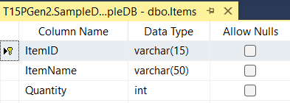
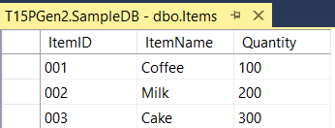
Overview Relational DB
Presents information in tables with rows and columns.
A table is referred to as a relation in the sense that it is a collection of objects of the same type (rows).
A Relational Database Management System (RDBMS)
Handles the way data is stored, maintained, and retrieved.
Ex: MS Access, MS SQL Server, Oracle
4
Notes:
Select @@version

Slide 5
RDBMS Structure Query Language (SQL)
Common DML – Data Manipulating Language queries.
SELECT columns FROM tables [WHERE condition]
UPDATE table SET column=value,… WHERE condition
DELETE FROM table WHERE condition
INSERT INTO table (col1, col2,…) VALUES ( val1, val2,…)
5

Slide 6
JDBC Overview
Java Database Connectivity
Is an application programming interface (API) for the programming language Java, which defines how a client may access a database
Provides access to DB and performs DB operations – CRUD(Create, Read, Update, Delete)

Slide 7
JDBC API
The JDBC™ API
Was designed to keep simple things simple such as executing common SQL statements, and performing other objectives common to database applications
Is a Java API that can access any kind of tabular data, especially data stored in a Relational Database.
Executes simple SQL queries in the Java code to retrieve data from database
The java.sql.* and javax.sql.* package provides database access in Java through directly or indirectly (Data source – flexible), and provides classes and interfaces that are used to interact with the database

Slide 8
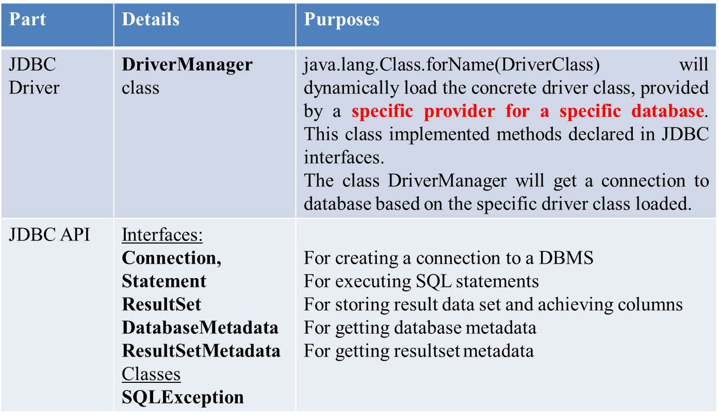
JDBC API
JDBC APIs has 02 parts in the java.sql package
Refer to the java.sql package for more details in Java documentation

Slide 9
JDBC API
Java App.
Connection con
Statement stmt
ResultSet rs
DriverManager
executeQuery()
createStatement()
Process rs
getConnection()
Specific JDBC Driver implement interfaces
(loaded dynamically by java.lang.Class)
Database
Model of a JDBC App.

Slide 10
JDBC API
DBMS provider/developer will supply a package in which specific classes implementing standard JDBC driver (free).
Based on characteristics of DBMSs, four types of JDBC drivers are:
Type 1: JDBC ODBC
Type 2: Native API
Type 3: Network Protocol
Type 4: Native Protocol
Type 1 and Type 4 are populated.

Slide 11
JDBC Drivers
Translates Java statements to SQL statements
Helps applications to interact with the database, using Java’s built-in Driver Manager
JDBC driver manager maintains a list of drivers created for different databases
JDBC drivers connect the Java application to the driver specified in the Java program
The four types of JDBC drivers are:
Type 1: JDBC ODBC
Type 2: Native API
Type 3: Network Protocol
Type 4: Native Protocol
Type 1 & Type 4 is populated

Slide 12
JDBC Type 1-Driver: JDBC-ODBC Bridge
Application
Java Application
Microsoft Technology
Type I JDBC-ODBC Bridge
SQL Command
Result Set
Mapping
<Datasource name, Data file>
MS ODBC Driver
MS Access Driver
MS Excel Driver
MS SQL Srv Driver
Oracle Driver
…
Database
Database
Database
Database

Slide 13
JDBC Type 1-Driver: JDBC-ODBC Bridge
This package is in the JDK as default.
Translates JDBC APIs to ODBC APIs
Enables the Java applications to interact with any database supported by Microsoft.
Provides platform dependence, as JDBC ODBC bridge driver uses ODBC
JDBC-ODBC bridge is useful when Java driver is not available for a database but it is supported by Microsoft.
Disadvantages
Platform dependence (Microsoft)
The performance is comparatively slower than other drivers
Require the ODBC driver and the client DB to be on the server.
Usage: DSN is registered to use connecting DB (a data source is declared in Control Panel/ODBC Data sources)

Slide 14
JDBC Type 2-Driver: Native API
Provides access to the database through C/C++ codes.
Developed using native code libraries
Native code libraries provide access to the database, and improve the performance
Java application sends a request for database connectivity as a normal JDBC call to the Native API driver
Establishes the call, and translates the call to the particular database protocol that is forwarded to the database
Application
Java Application
Type II JDBC Driver
SQL Command
Result Set
Native Database Library
Proprietary Protocol
Database

Slide 15
JDBC Type 3-Driver: Network Protocol
Use a pure Java client and communicate with a middleware server using a database-independent protocol.
The middleware server then communicates the client’s requests to the data source
Manages multiple Java applications connecting to different databases
Application
Java Application
Type III JDBC Driver
Result Set
Middleware
JDBC
Database

Slide 16
JDBC Type 4-Driver: Native Protocol
Communicates directly with the database using Java sockets
Improves the performance as translation is not required
Converts JDBC queries into native calls used by the particular RDBMS
The driver library is required when it is used and attached with the deployed application (sqlserver 2000: mssqlserver.jar, msutil.jar, msbase.jar; sqlserver 2005: sqljdbc.jar; jtds: jtds.jar …)
Independent platform
Application
Java Application
Type IV JDBC Driver
SQL command
Result Set
use Proprietary protocol
Database

Slide 17
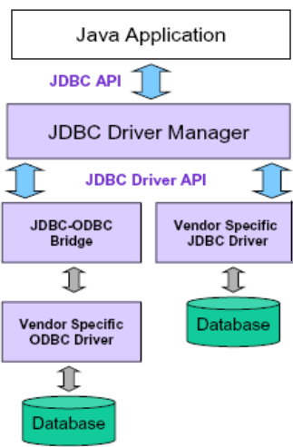
JDBC Summary

Slide 18
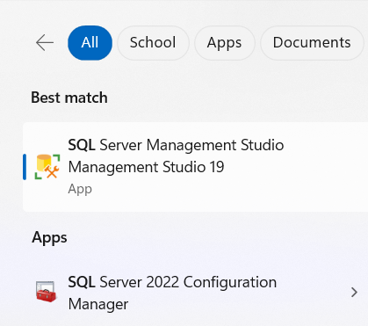
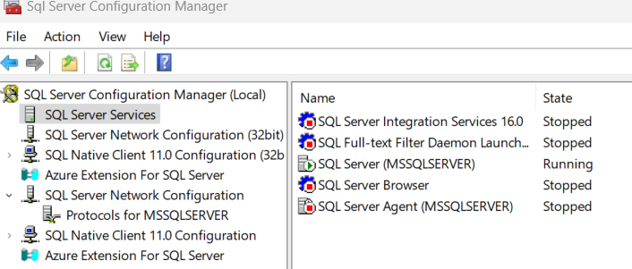
JDBC API Download Driver & Configure RDBMS
Download:
Download Microsoft JDBC Driver for SQL Server - SQL Server | Microsoft Docs
Configuration
Using SQLServer Configuration Manager
Configure ports, protocol
Open C:\Windows\SysWOW64\SQLServerManager1x.msc
( used for SQL Server 2012 (v11) to SQL Server 2022(v16) )

Slide 19
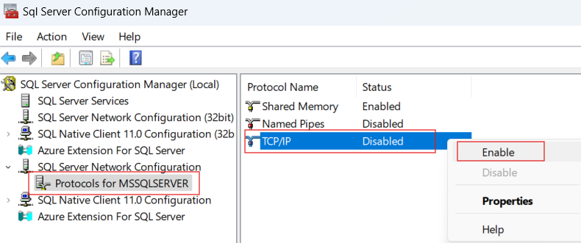
Config SQL Server
Configure Ports, Protocols for SQL Server.
1

Slide 20
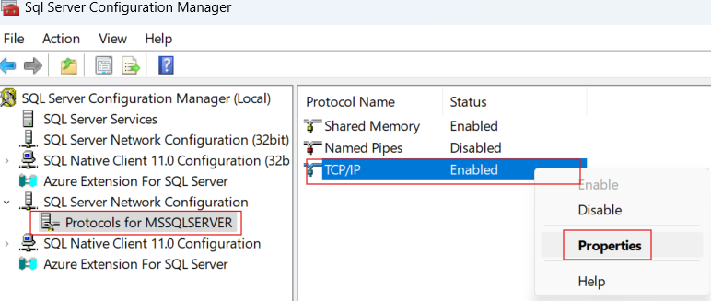
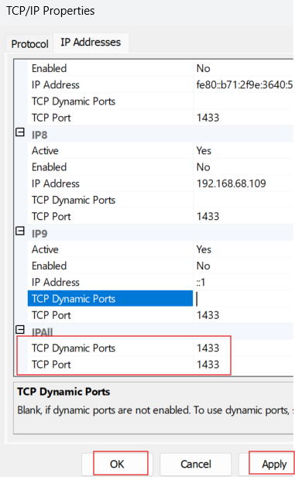
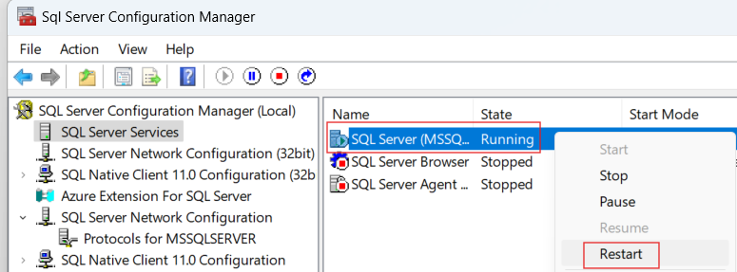
Config SQL Server
Configure Ports, Protocols for SQL Server.
2
3

Slide 21
JDBC API
How to connect DB
Required
RDBMS: SQL Server 2017 / 2019
Driver Connection: sqljdbc42.jar
Steps
Load Driver
using Class.forName method
Driver string: com.microsoft.sqlserver.jdbc.SQLServerDriver
Exception: ClassNotFoundException
Create connection String
protocol:server://ip:port;databaseName=DB[;instanceName=Instance]
Open connection
Connection con = DriverManager.getConnection(url, “user", “pass");
Exception: SQLException
More: https://learn.microsoft.com/en-us/sql/connect/jdbc/microsoft-jdbc-driver-for-sql-server-support-matrix?view=sql-server-ver16

Slide 22
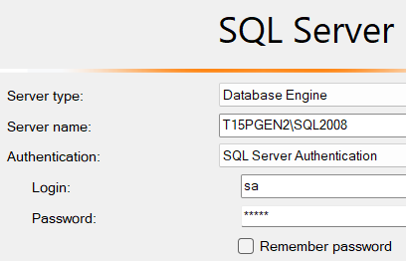
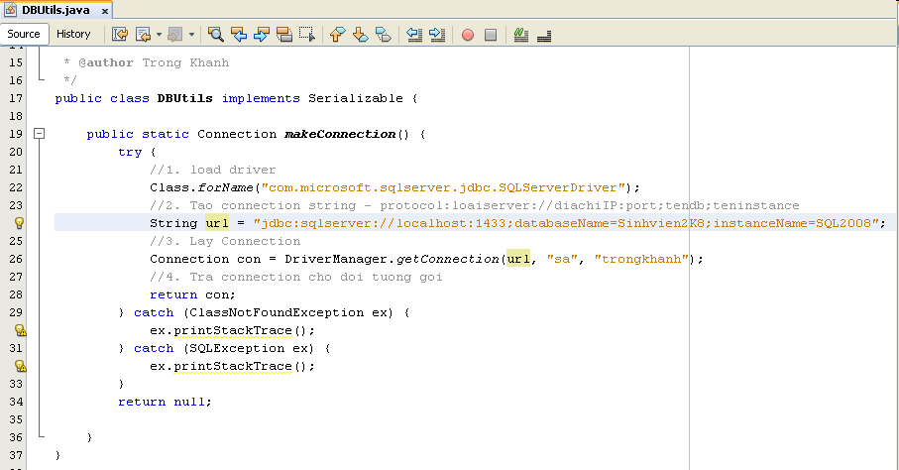
JDBC API
How to connect DB
Implementation

Slide 23
JDBC API
How to access DB using JDBC API
Required : DB is connected
Steps
Connect DB using method that you are built
Check available DB connection
Create SQL String using DML
Create Statement
There are 03 types of Statement
Statement
PreparedStatement (prepareStatement).
Ex: Select * From Registration Where userName = ?
CallableStatement (prepareCall()). Ex: {call spInsertUser (?,?,?,?)}
Execute Query to get ResultSet
Process the ResultSet
Notes: must closed all objects that are created after process had finished

Slide 24
JDBC API Statements
Sends queries and command to the database
Ex: “Select * From Registration”
Is Created from the Connection object
Statement stmt = con.createStatement();
Statement stmt = con.createStatement(rsType, rsConcurrency)
rsType: TYPE_FORWARD_ONLY, TYPE_SCROLL_INSENSITIVE, TYPE_SCROLL_SENSITIVE
rsConcurrency: CONCUR_READ_ONLY, CONCUR_UPDATABLE

Slide 25
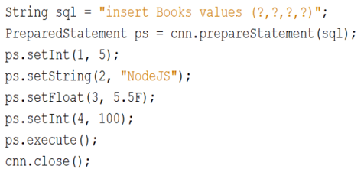
JDBC API Prepared Statements
To execute a Statement object many times, it normally reduces execution time to use a PreparedStatement object instead.
PreparedStatement stm = con.prepareStatement(sql);
Supplying Values for PreparedStatement Parameters:
To supply values to be used in place of the question mark placeholders (if there are any) before a PreparedStatement object is executed.
One of the setXXX methods is called in the PreparedStatement class.
stm.setXXX(Cardinal number, values);
Ex:
stm.SetInt(1, 5);
stm.SetString(2, “abc”);

Slide 26
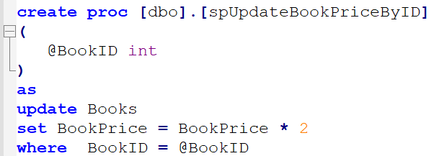
JDBC API Callable Statements
To execute the stored procedure, the Callable Statement is used
CallableStatement cs = con.prepareCall("{call stored_p_name(?)}");
-Example:
String strSQL = "{call spUpdateBookPriceByID(?)}"; CallableStatement cs = cnn.prepareCall(strSQL); cs.setInt(1,Integer.parseInt(txtBookID.getText())); cs.execute();

Slide 27
JDBC API Execute Query
Used to execute statement and get data from DB
The executeQuery() method
Is used to Query commands and stored procedure. Ex:
String strSQL = “Select * From Registration”;
Returns an object of type ResultSet
ResultSet rs = stmt.executeQuery(strSQL);
The executeUpdate() method
Is used to Insert, Update, or Delete commands. Ex
String strSQL = “Insert into Registration Values(“UserName”, “Tom”);
Returns the row of executed validation.
int nRow = stmt.executeUpdate(strSQL);
The execute() method
Is use to create and delete DB objects as table, DB ...Ex:
String strSQL = “Drop table Registration”;
stmt.execute(strSQL);

Slide 28
JDBC API Process the Results
The ResultSet class implements a collection of type Set and allows to use it to process one row at the time
Apply to the ResultSet object
The getXxx (cardinal number/ field name string) of the ResultSet object is used to get the field value.
Cardinal number starts with 1
Xxx is a DataType of the selected field
The next() method of the ResultSet object is used to process the results from the DB
Ex: while(rs.next()) (Point the cursor next row) {
rs.getInt(1) or rs.getInt(“userId”);
rs.getString(1) or rs.getString(“username”); }
Notes: The field must be accessed in the order
The 2D Resultset support the access methods to DB as first, isFirst, last, ...
There is a class ResultSetMetaData that helps to determine the number, names and types of column in the ResultSet
Close the connection after used: The close() method is used. Ex: con.close();

Slide 29
JDBC API Some methods of ResultSet
Methods | Description
getString() | Takes column number as an argument and returns value from the specified column number as a string to the ResultSet object
getInt() | Takes column number as an argument and returns the value from the specified column number as an integer to the ResultSet object
getFloat() | Takes column number as an argument and returns the value from the specified column number as float type to the ResultSet object
getDate() | Takes column number as an argument and returns the value from the specified column number as java.sql.Date to the ResultSet object
findColumn() | Takes a column name as a string parameter and returns the column index of the specified column name
wasNull() | Returns true if the last column value read was SQL NULL
getMetaData() | Returns the information about the columns of ResultSet object in a ResultSetMetaData class

Slide 30
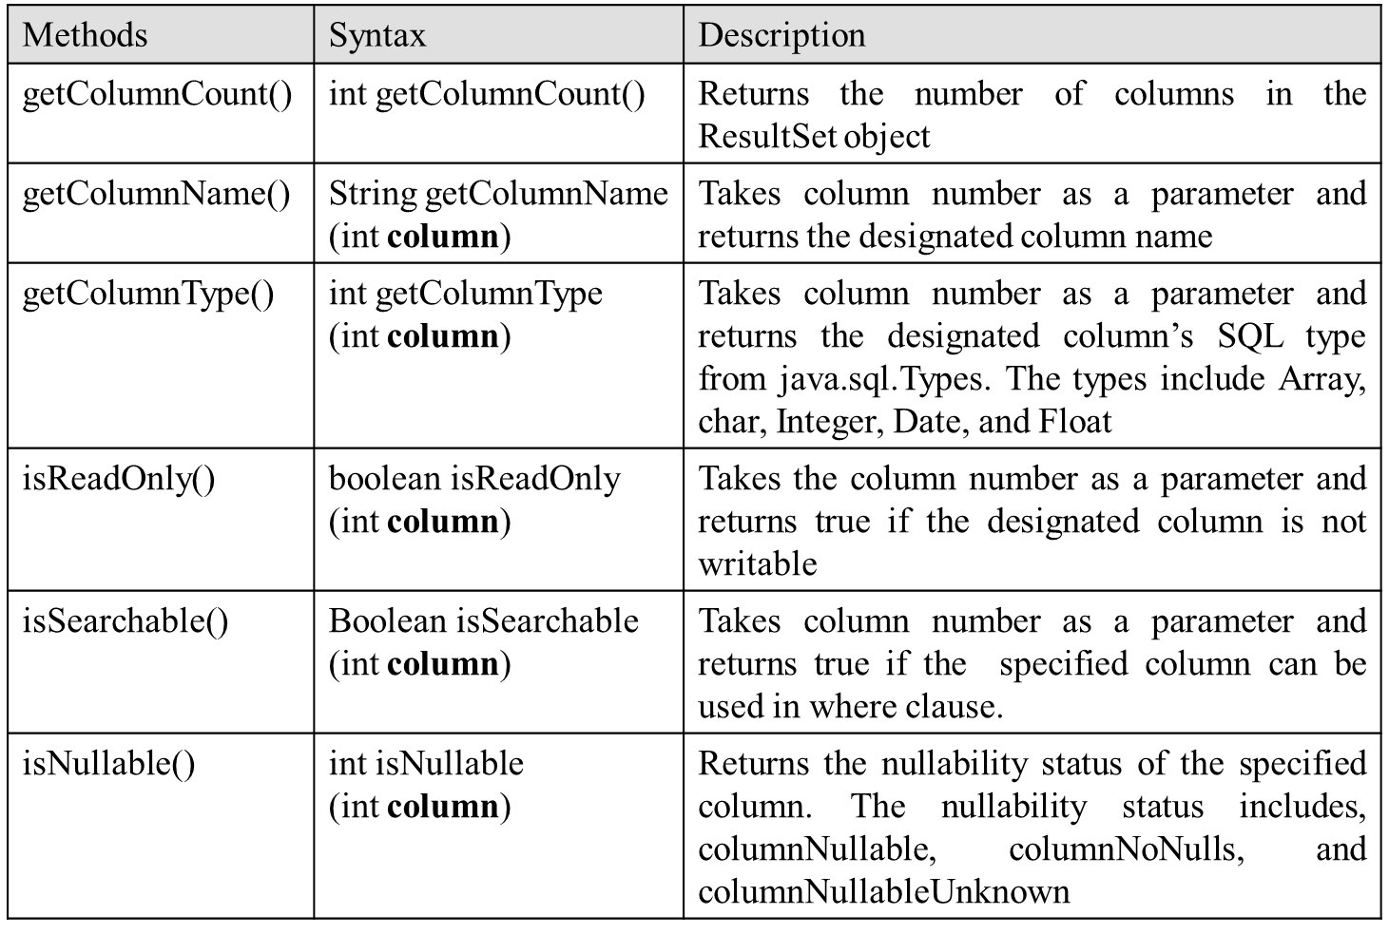
JDBC API Some method of ResultSetMetaData

Slide 31
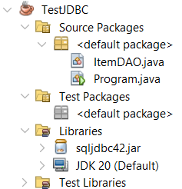

JDBC API
How to access DB
Implementation
On the project, right-click on Libraries | Add JAR/Folder then select sqljdbc42.jar driver or another that matches of Sql Server version on the machine.

Slide 32
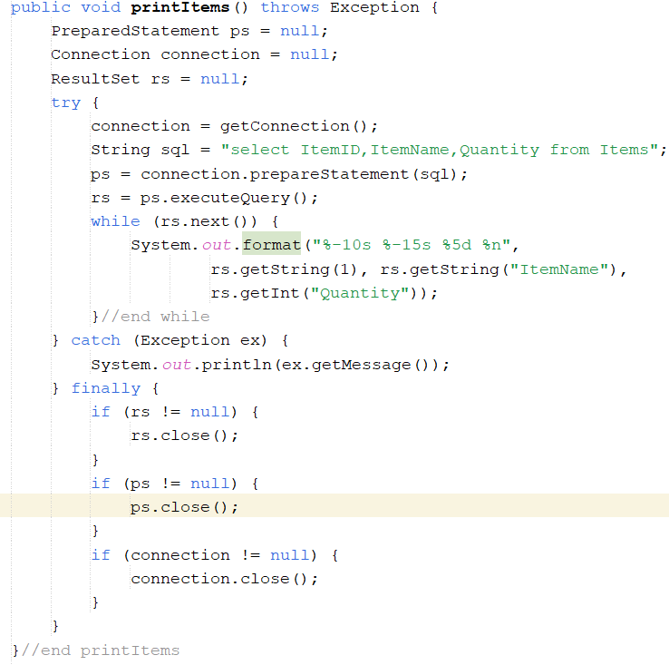
JDBC API
How to access DB
Implementation

Slide 33
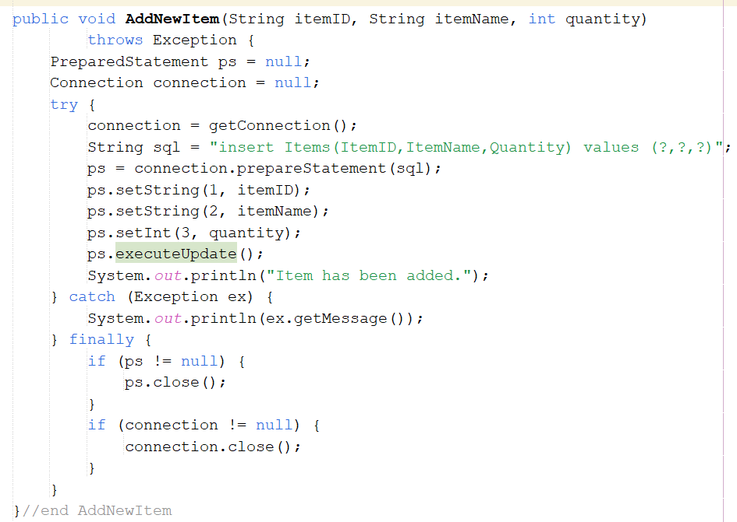
JDBC API
How to access DB
Implementation

Slide 34
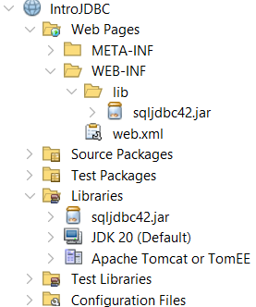
Practice
Create web project named IntroJDBC
Use the SampleDB database in the Slide 4
In the WEB-INF, create the folder named lib then copy sqljdbc42.jar into lib folder
On the project, right-click on Libraries | Add JAR/Folder , select sqljdbc42.jar driver in the WEB-INF\lib folder

Slide 35
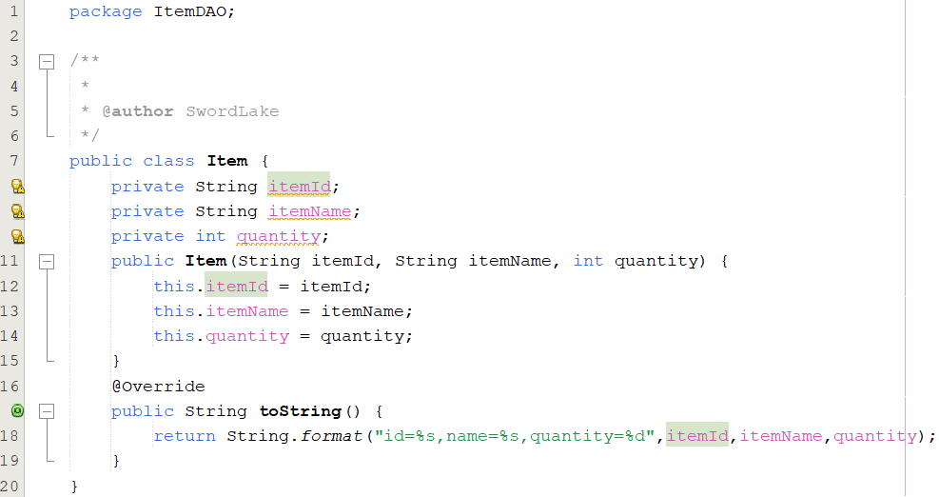
Practice
Write codes for Item.java

Slide 36
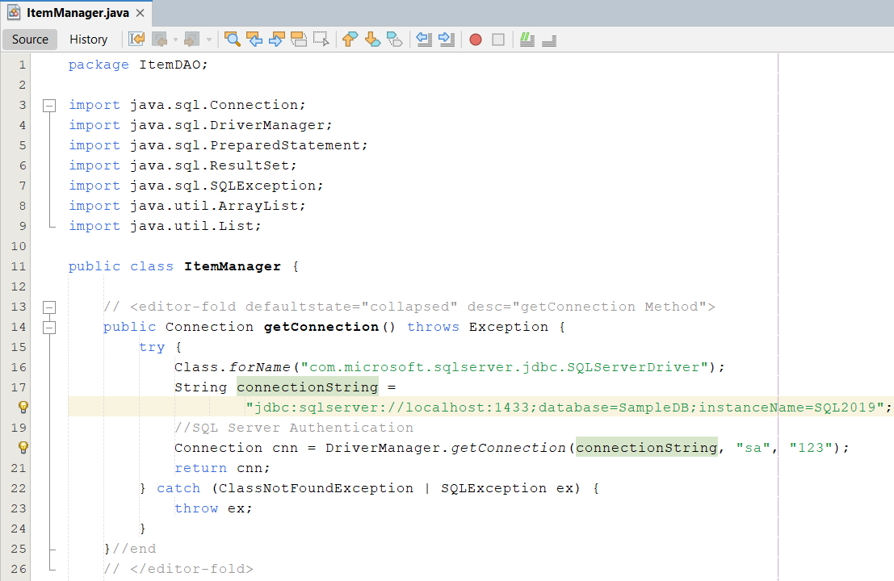
Practice
Write codes for ItemManager.java

Slide 37
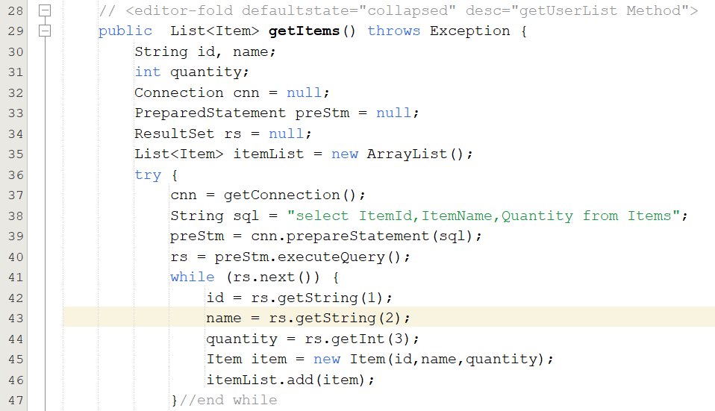
Practice

Slide 38
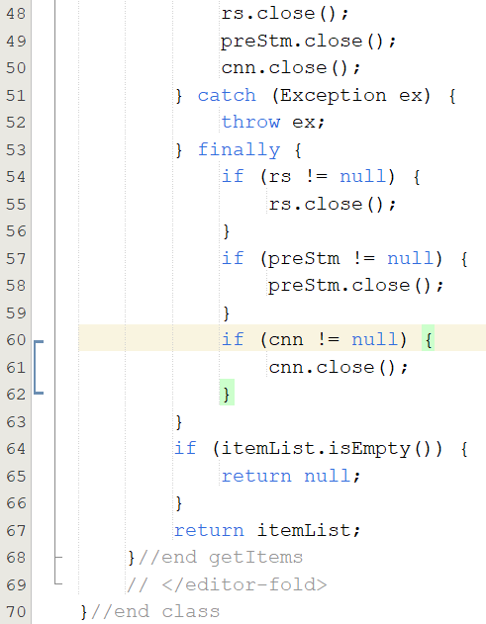
Practice

Slide 39
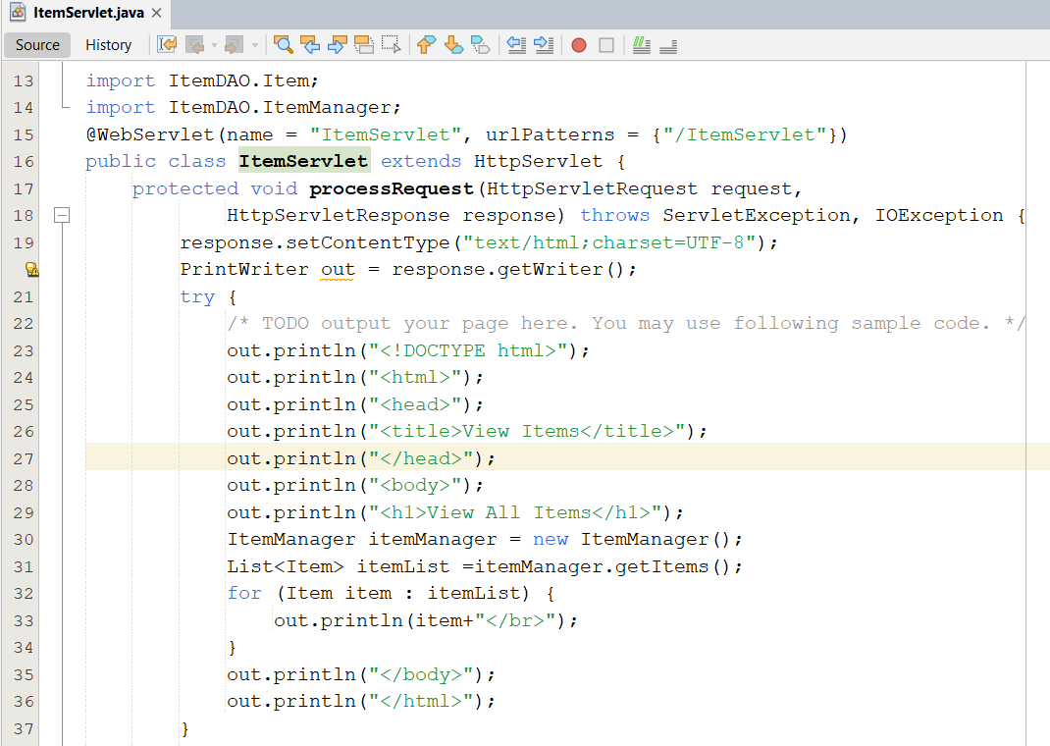
Practice
Write codes for ItemServlet.java

Slide 40
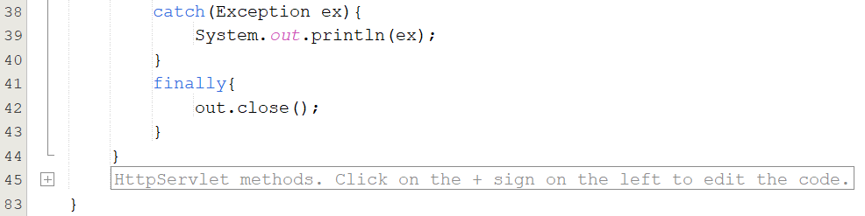
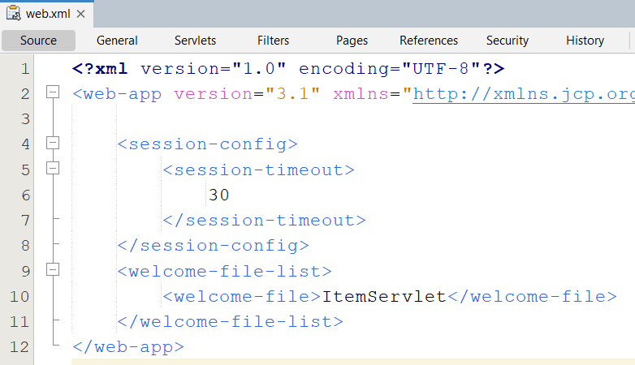
Practice
Update web.xml file

Slide 41
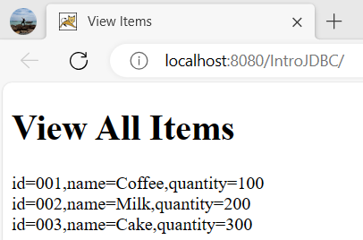
Practice
Run project

Slide 42
Summary
How to access database from web application?
JDBC
Relational Database Overview
JDBC and JDBC Drivers
JDBC Basics: Processing SQL Statements
Implement CRUD application using MS SQL
Q&A

Slide 43
Practice
Do Lab02_JDBC_WebApp.pdf

Slide 44
Exercises
Do it again all of demos
Using servlet to write the programs as the following requirement
Present the Login form (naming LoginServlet) with title Login, header h1 – Login, 02 textbox with naming txtUser and txtPass, and the Login button
Rewrite above Login application combining with DB
Writing the ColorServlet that presents “Welcome to Servlet course” with yellow in background and red in foreground
Writing the ProductServlet includes a form with a combo box containing strings : Servlet & JSP, Struts & JSF, EJB, XMJ, Java Web Services, and the button with value Add to Cart

Slide 45
Next Lecture
How to deploy the Web Application to Web Server?
Web applications Structure
Request Parameters vs. Context Parameters vs. Config/Servlet Parameters
Application Segments vs. Scope
How to transfer from resources to others with/without data/objects?
Attributes vs. Parameters vs. Variables
Redirect vs. RequestDispatcher
RequestDispatcher vs. Filter

